Slide 1
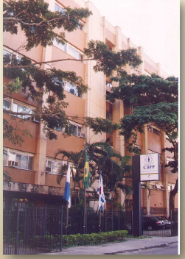
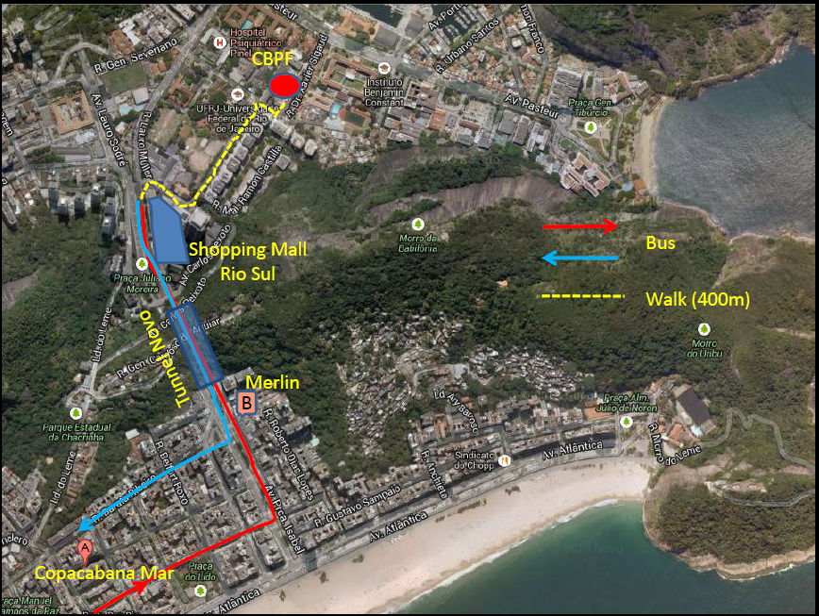
WELCOME TO IWARA
You are here ...
http://www.cbpf.br/iwara

Slide 2
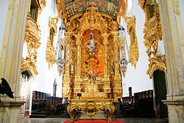
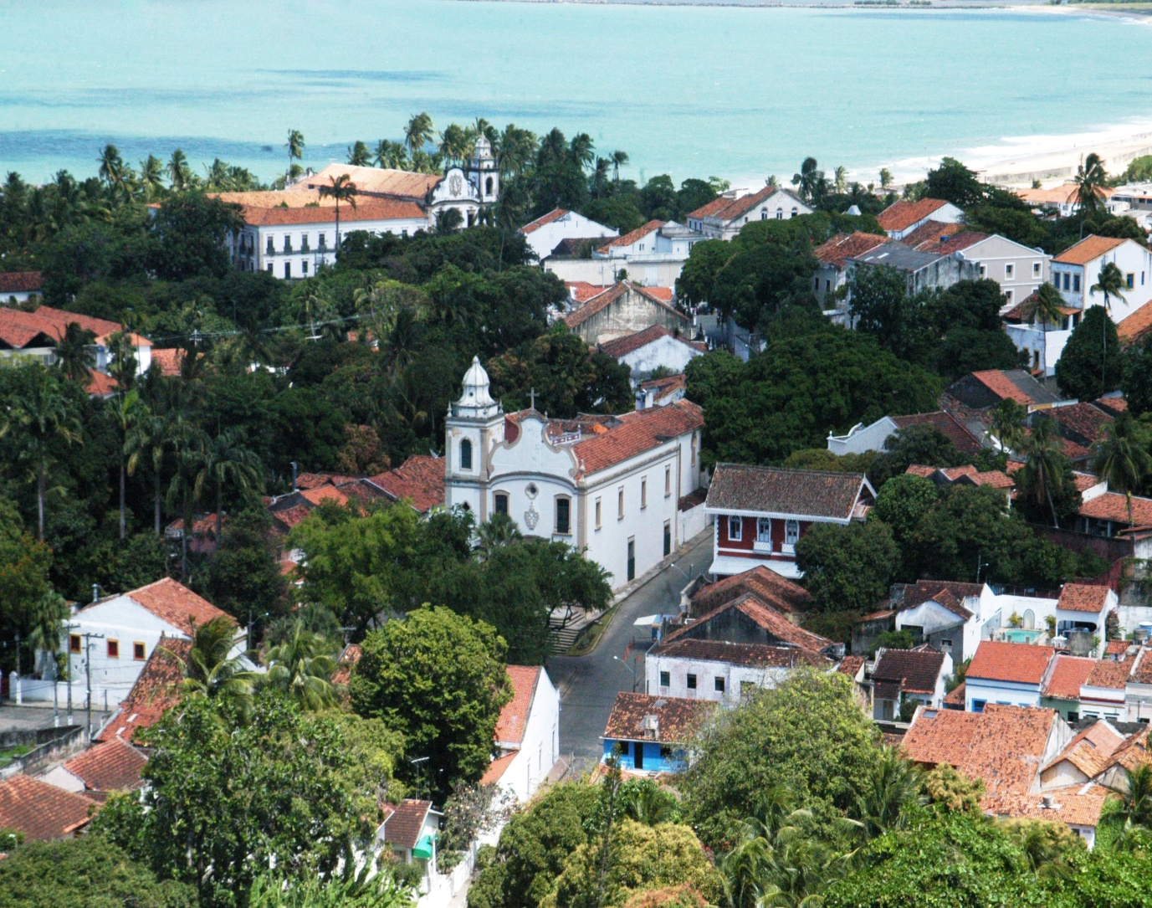
Main altar of São Bento church in Olinda, Brazil
The First IWARA
in Olinda-PE
The Historical Beautiful Town
Besides its natural beauty, Olinda is also one of the most important of Brazil's cultural centers.
Declared in 1982 a Historical and Cultural Patrimony of Humanity by the UNESCO, Olinda relives the magnificence of the past every year during the Carnival, in the rhythm of frevo, maracatu and others rhythms.

Slide 3
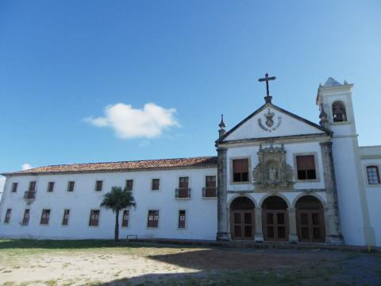
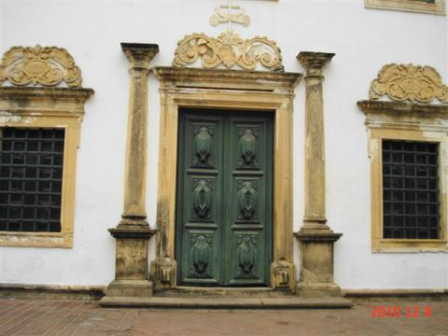
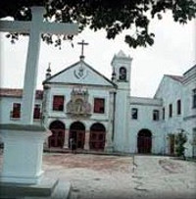
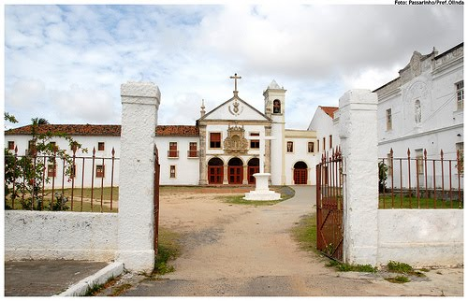
First IWARA edition in OLINDA
To combine with the spirit of the town the first IT
took place in a convent founded in the VI century

Slide 4
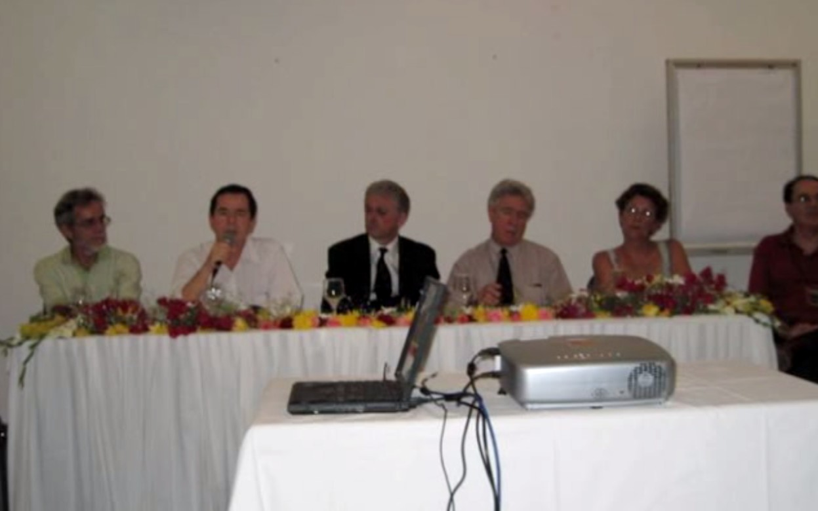
The opening of First IWARA

Slide 5
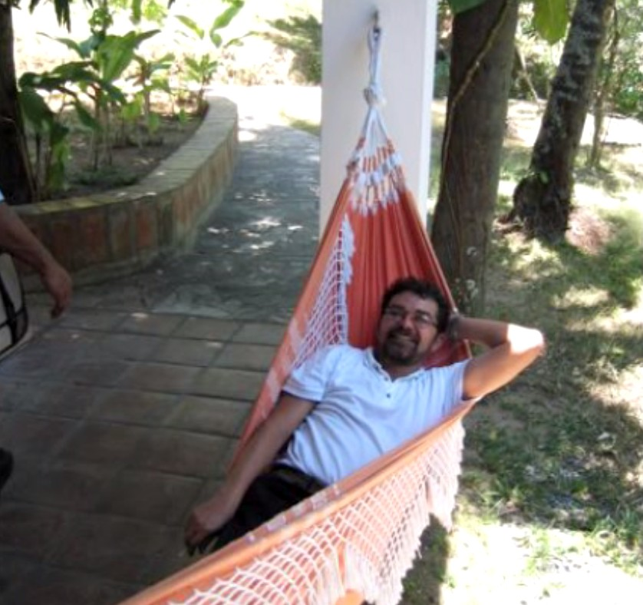
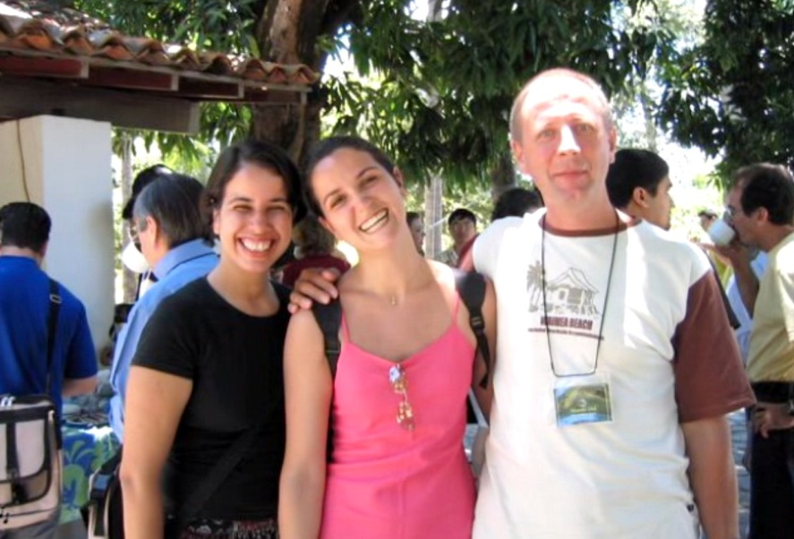
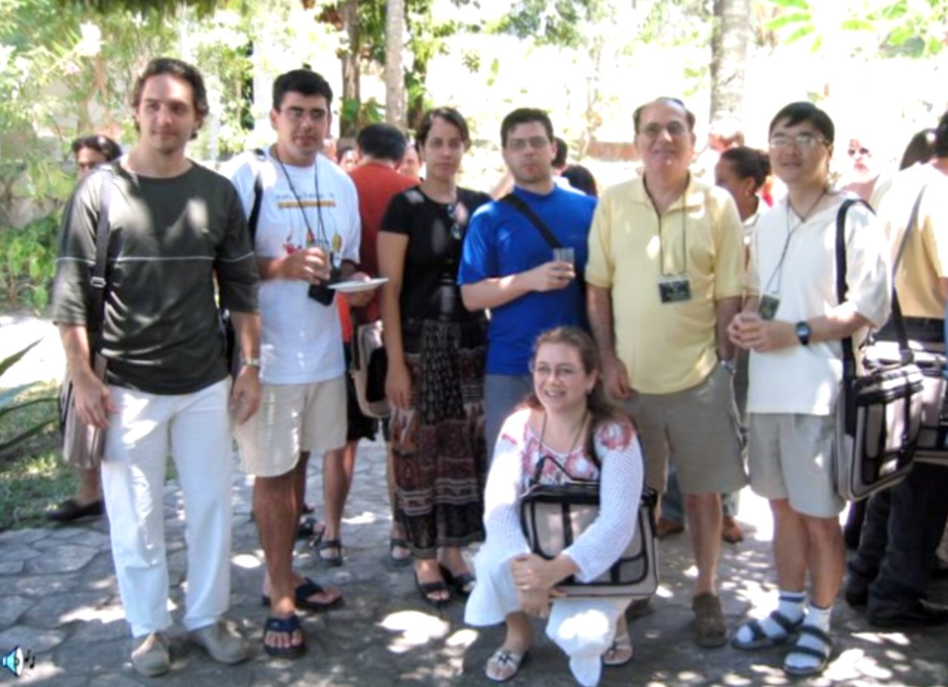
DISCUSSING PHYSICS IN A FRIENDLY AND RELAXING WAY

Slide 6
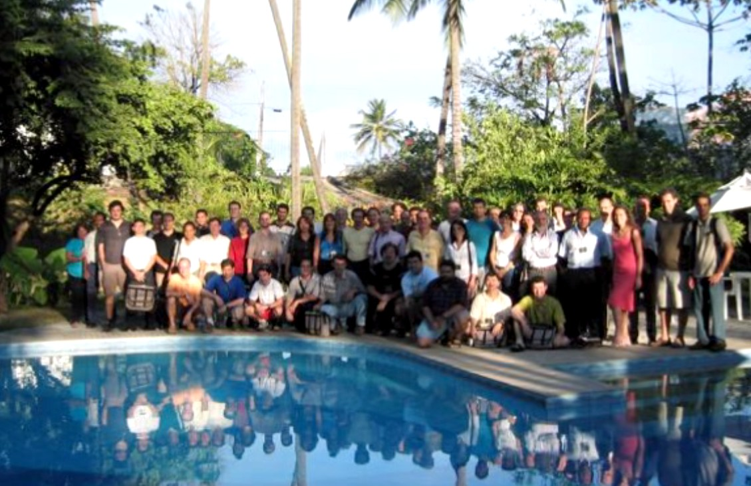
The EVENT PHOTO
I

Slide 7
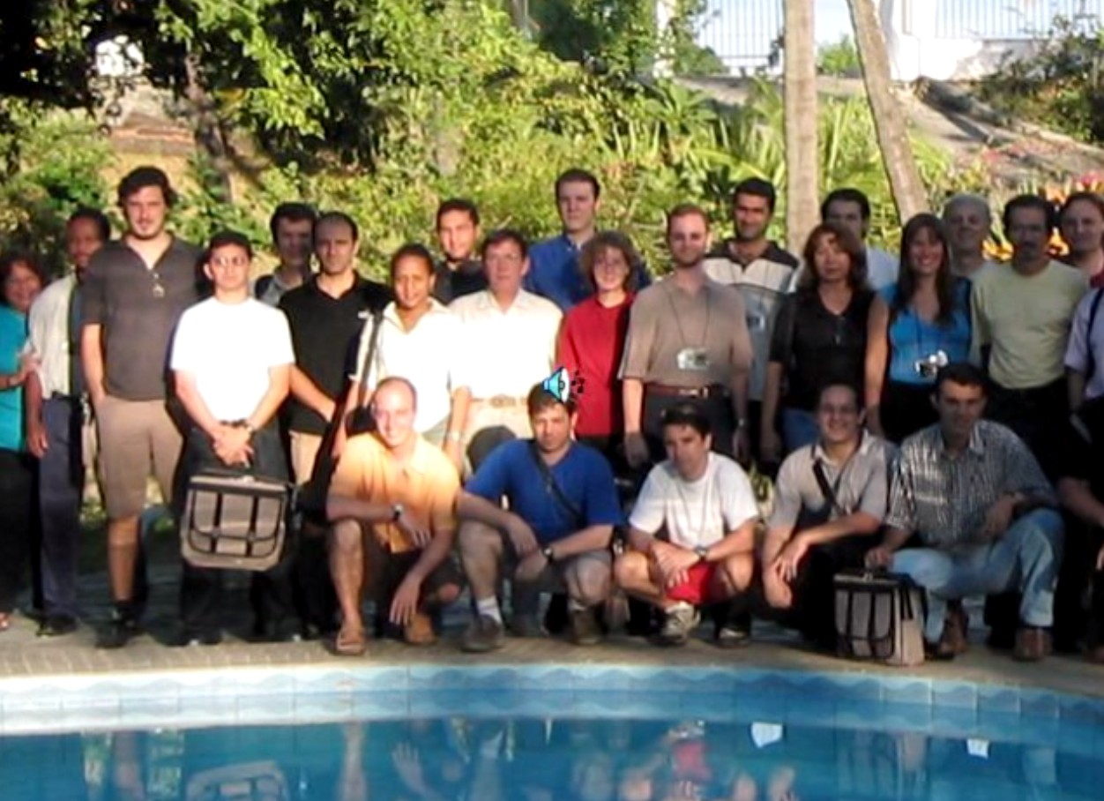
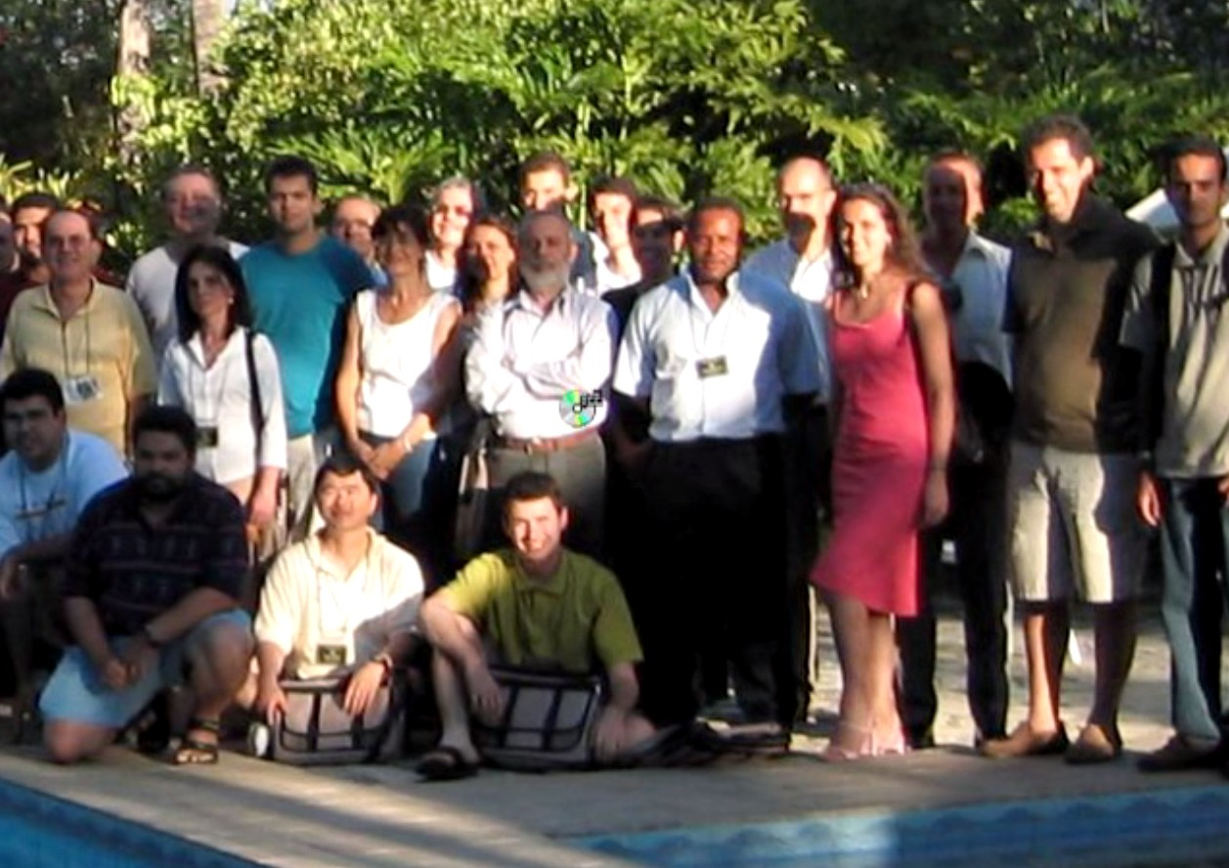
The Photo in two steps

Slide 8
The funny Photo

Slide 9
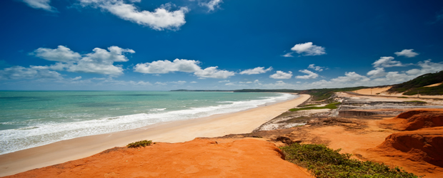
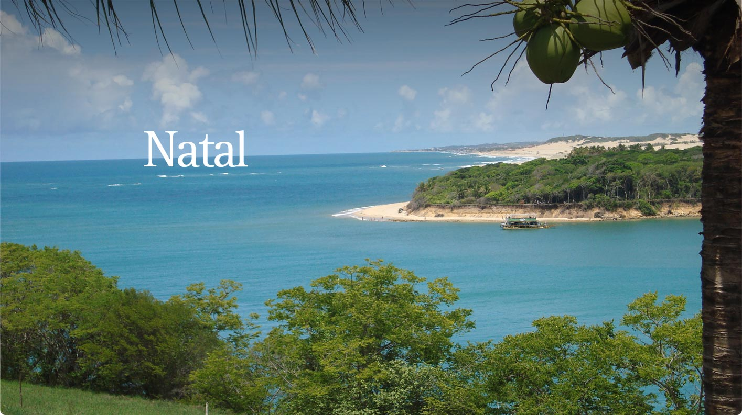
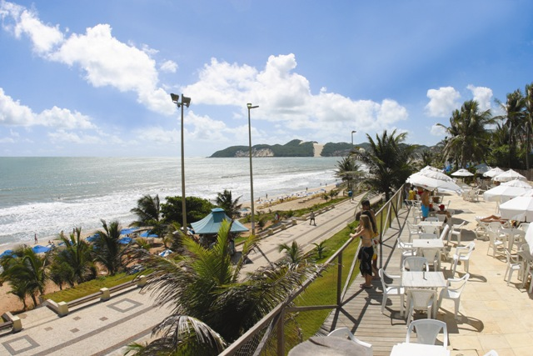
II IWARA Took place in nATAL– Rn the sun shining city

Slide 10
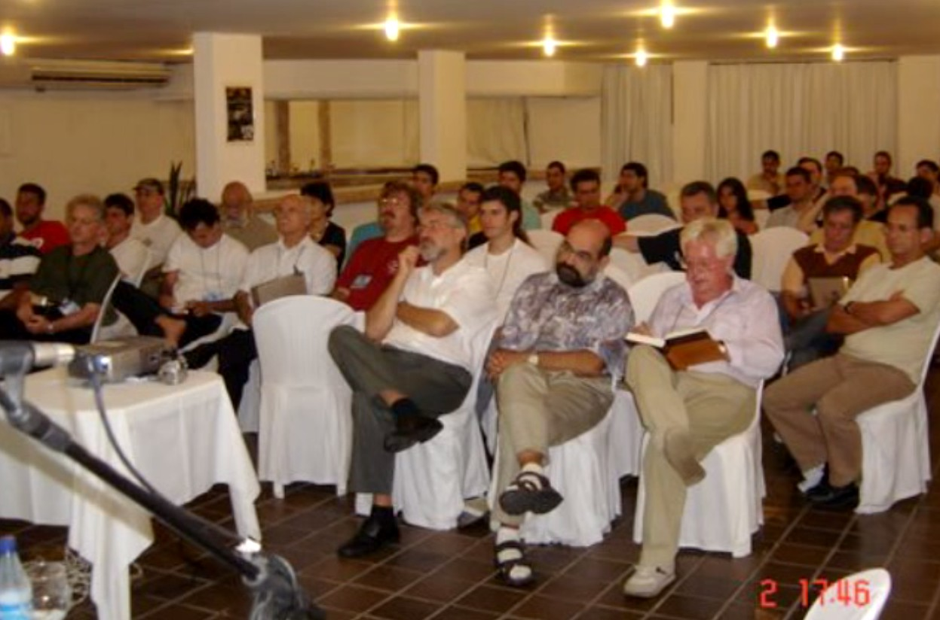
The audience on the first conference day

Slide 11
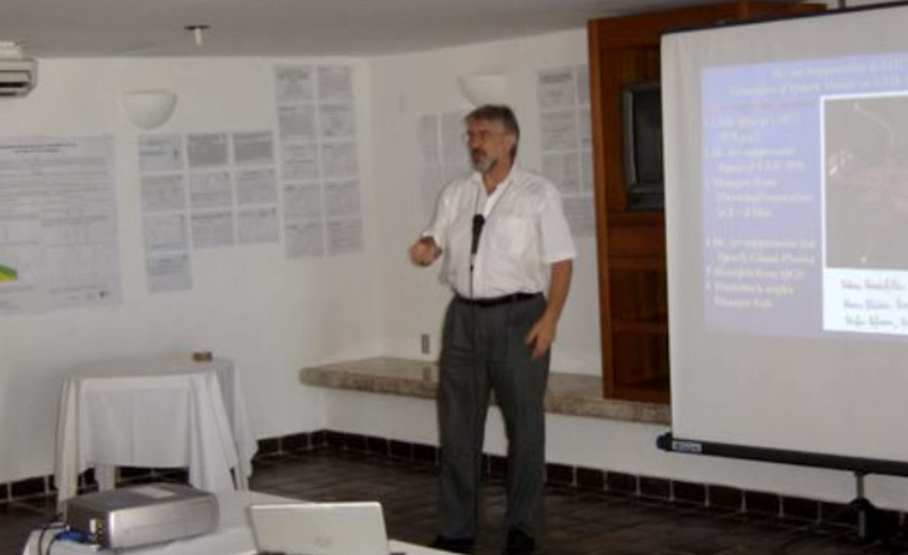
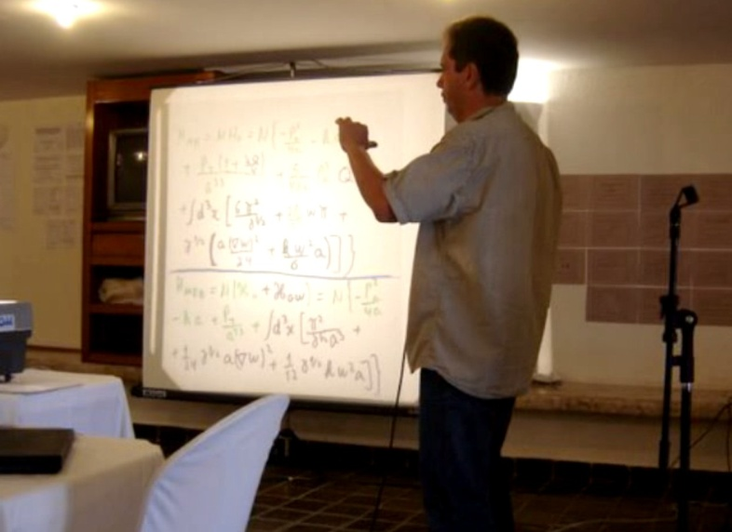
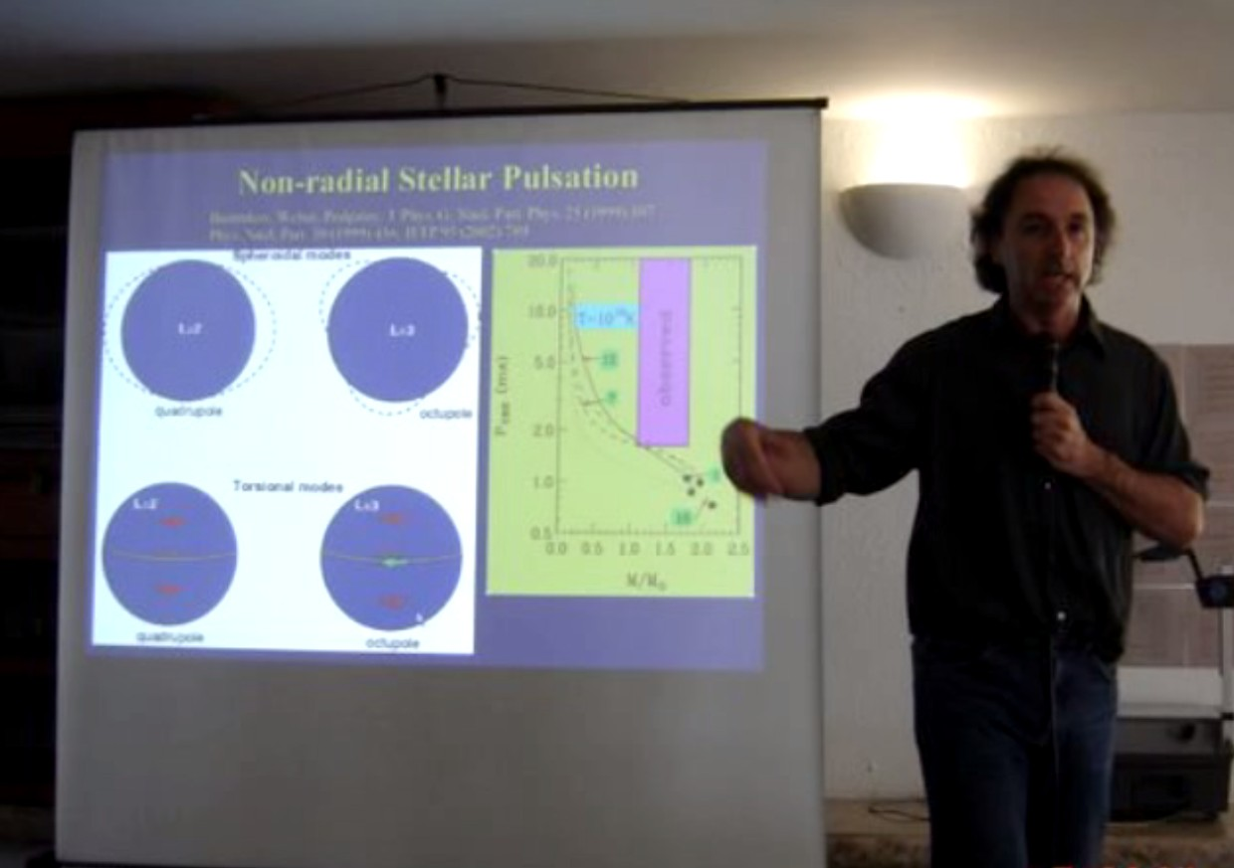
In a hard Work

Slide 12
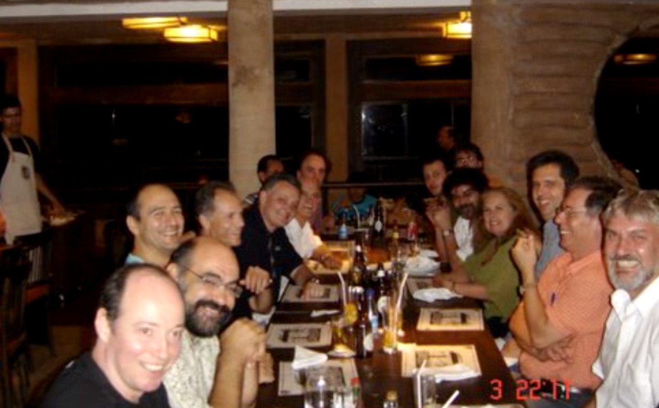
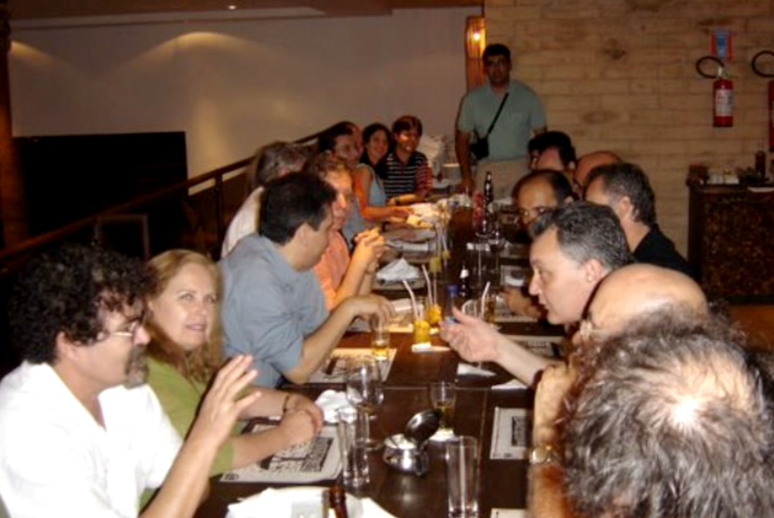
During the conference dinner

Slide 13
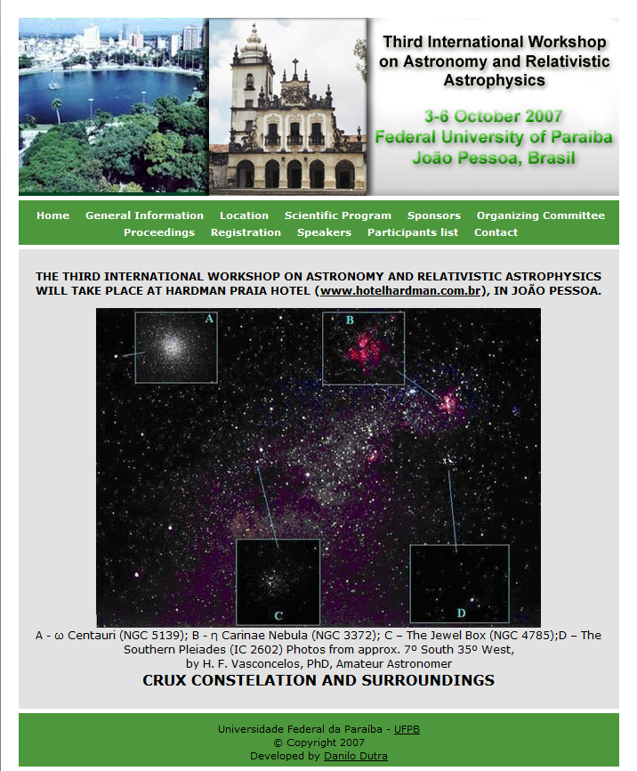
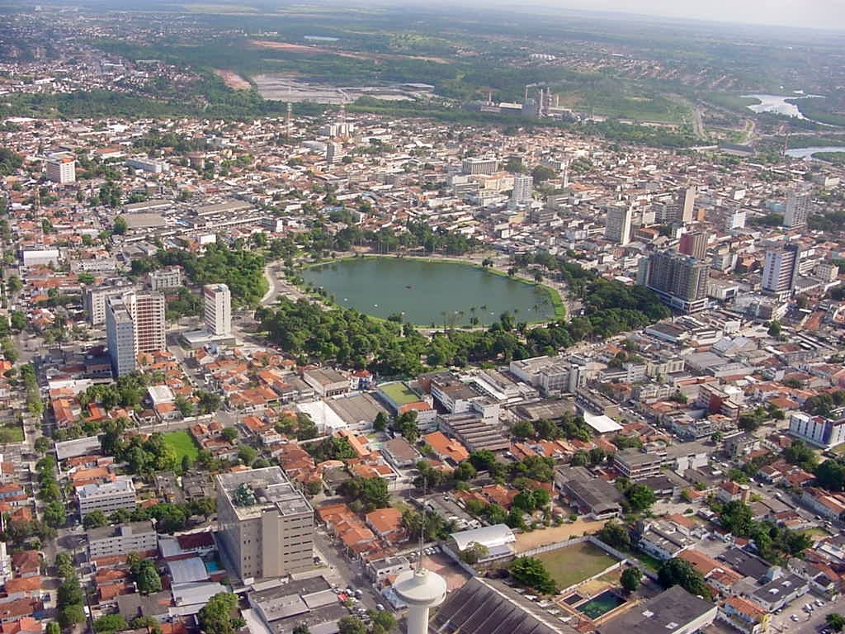
3th IWARA - JOÃO PESSOA,
IN THE northeast COaST
Of our country
View of the city with
the lake

Slide 14
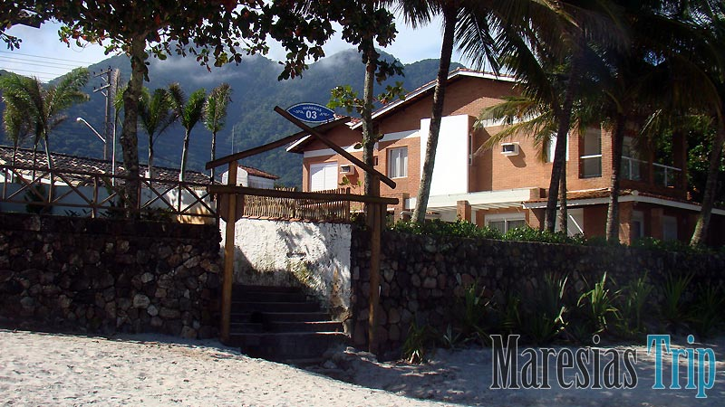
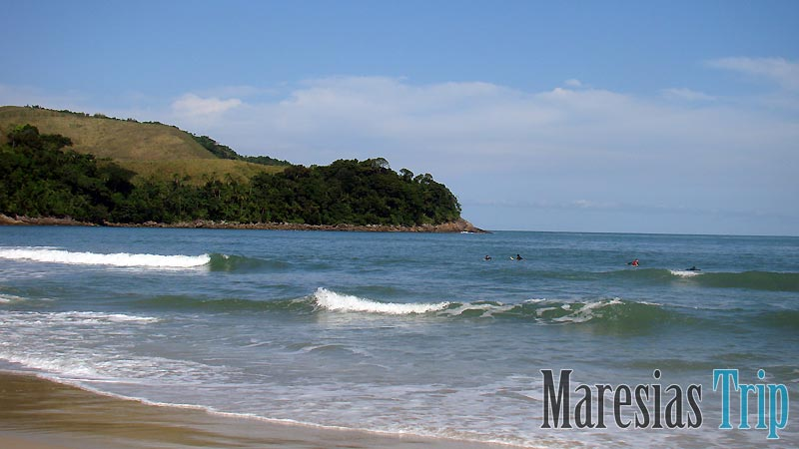
4th IWARA MARESIAS beach
At São Paulo state cost

Slide 15
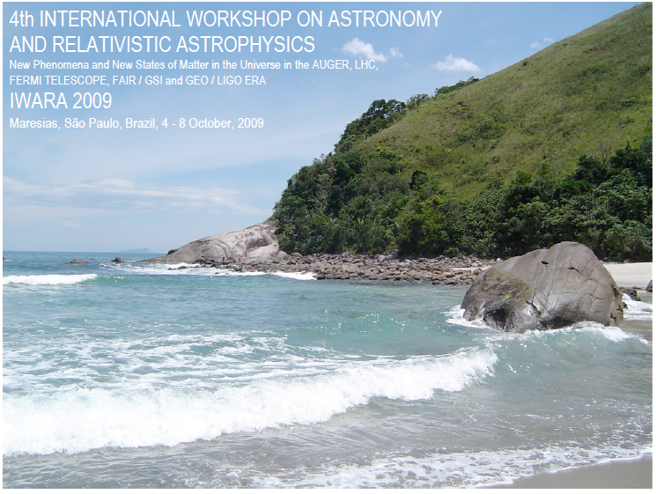

Slide 16
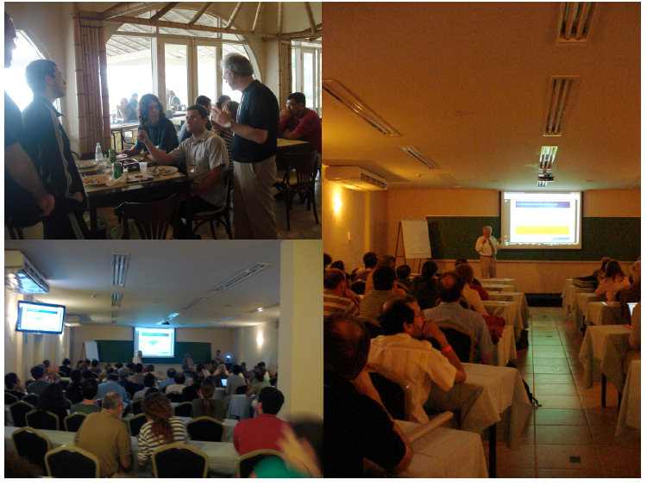

Slide 17
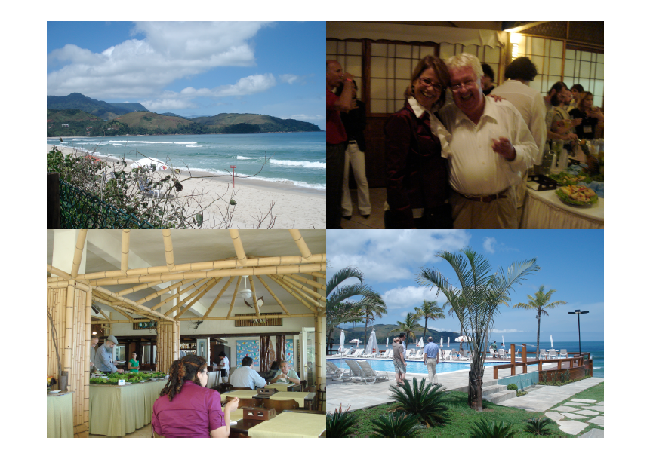
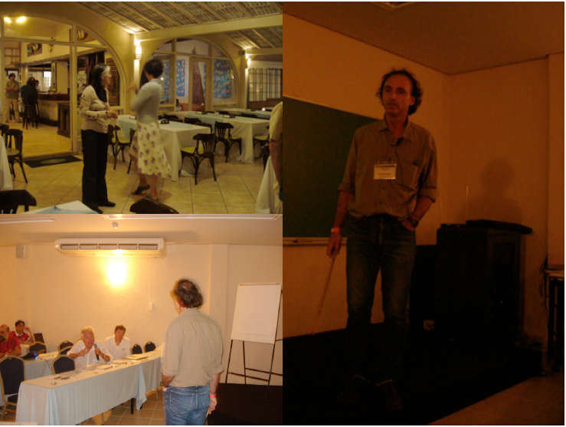

Slide 18
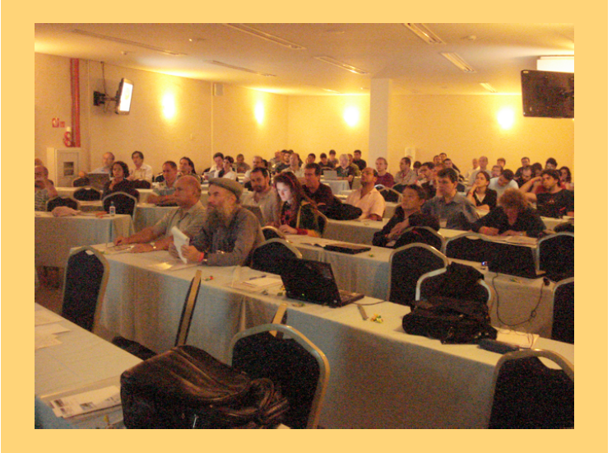

Slide 19
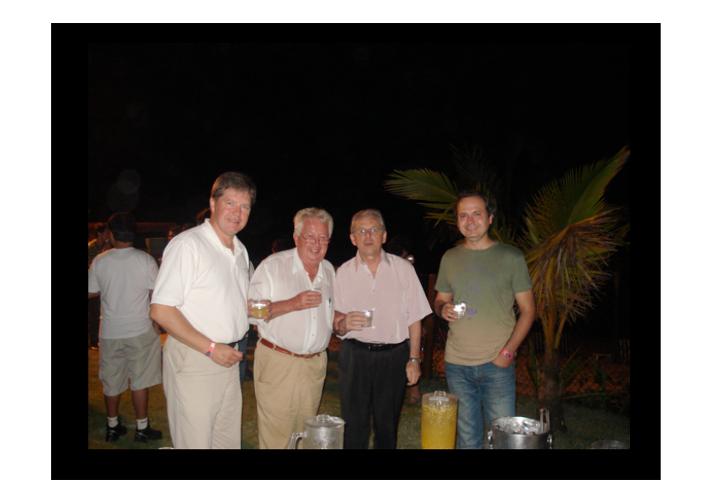

Slide 20
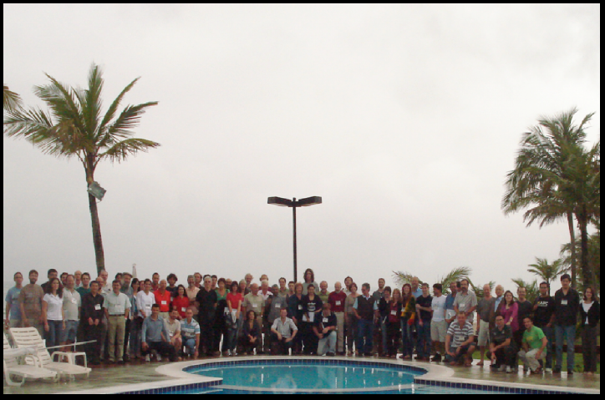
4th IWARA - the event photo

Slide 21
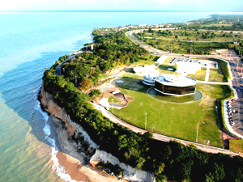
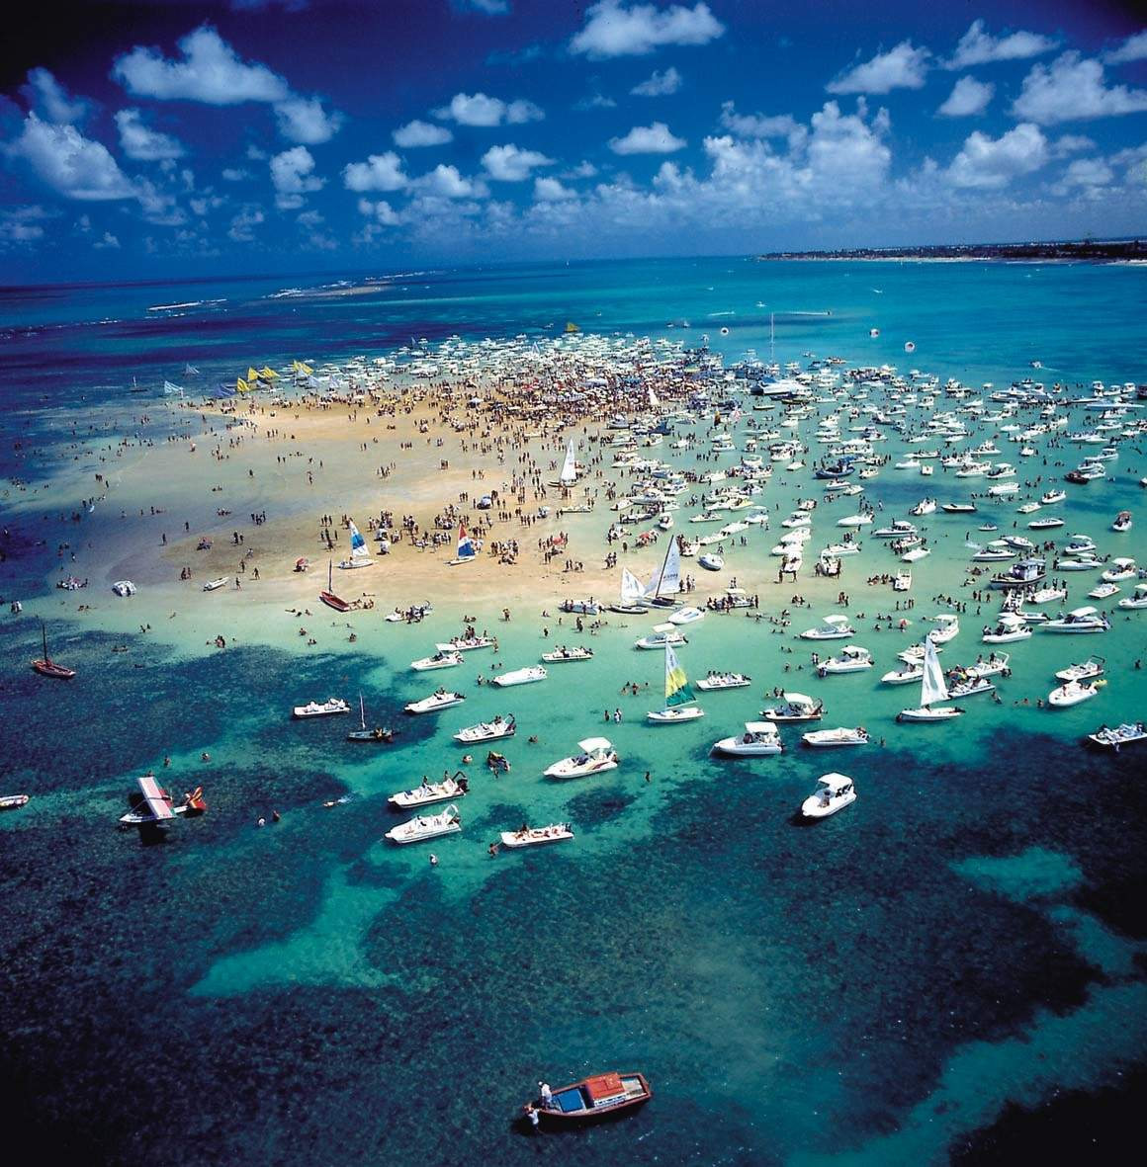
5th IWARA - João Pessoa - PB
International Journal of Modern Physics: Conference Series
Proceedings of the 5th International Workshop on Astronomy and Relativistic Astrophysics (IWARA2011); João Pessoa, Brazil, 9-11 October 2011; Editors: Valdir B. Bezerra, Marcelo J. Rebouças, Dimiter Hadjimichef, Cesar A. Zen Vasconcellos, Jorge E. Horvath, and Eugênio R. Bezerra de Mello
Volume 18 (2012)

Slide 22
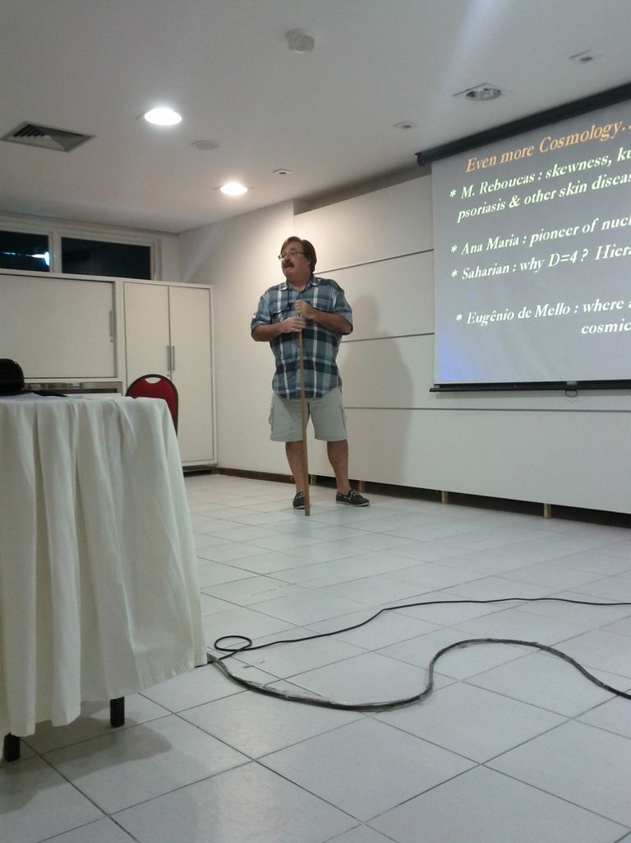
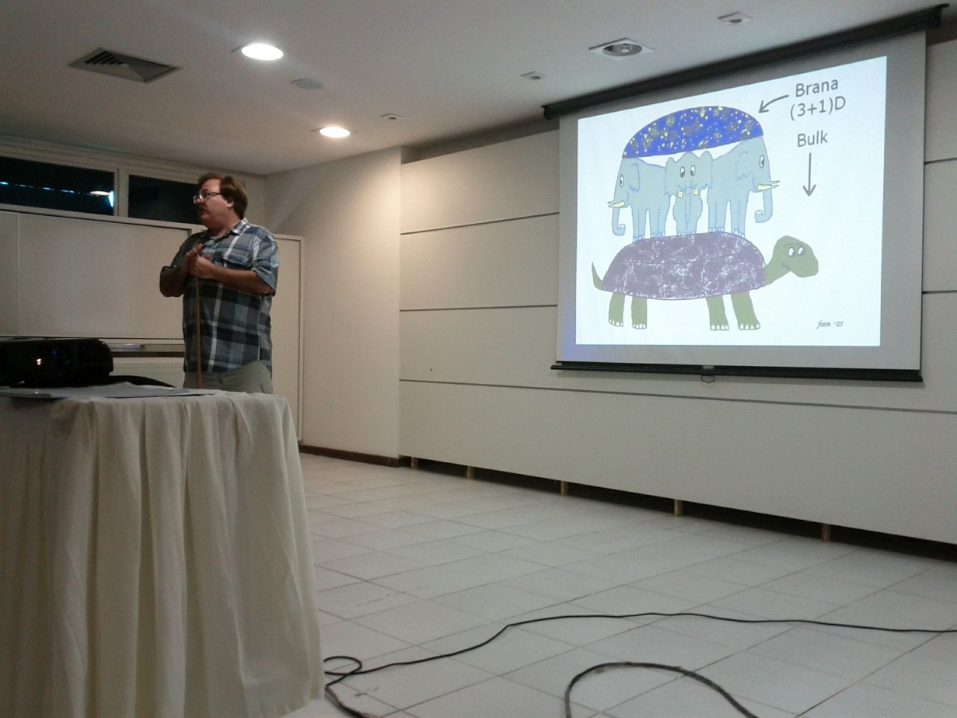
5th IWARA - João Pessoa - PB
J. Hovarth concluding section

Slide 23
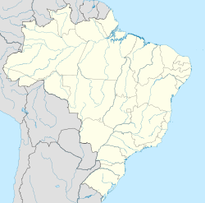
IWARA BEGANS
IN a pretty town with beuty even in its name
Northeast cost
Natal /RGN
João Pessoa /PB
Olinda /PE
Southeast cost
Rio de Janeiro/RJ
Maresias/SP
Now It takes place
in the
wonderful city

Slide 24
Have a nice MEETING...

